Slide 1
Remote controlled car
An Electronic Circuits Project

Slide 2
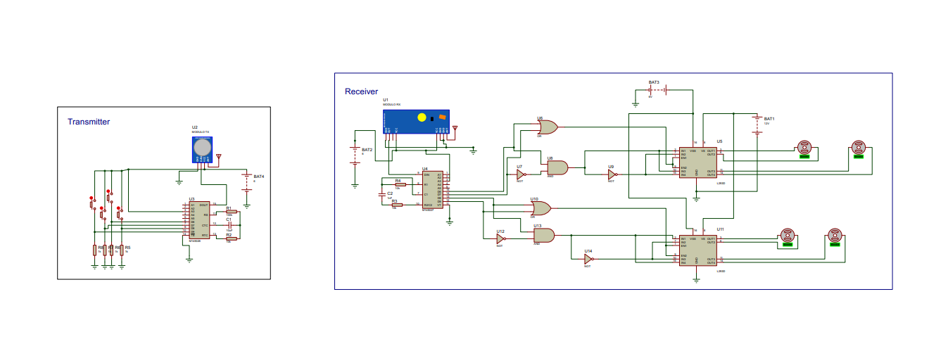

About the project
Our project consists of two major circuits, the remote circuit which translates your inputs into signals and sends it to the other circuit which translates the signals into instructions that controls the motors according to your inputs.

Slide 3
The Remote circuit

Slide 4
The remote circuit
Interactive Buttons
Encoder
4 buttons in pull-down configuration
An IC that encodes the address and the data bits into serial output.
Transmitter
Power Supply
A kit that uses the encoded signal for ASK modulation and send the modulated signal through the antenna.
A simple 9V battery.

Slide 5
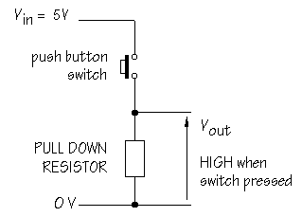
Pull-Down Buttons
The output is normally grounded (low),but when the button is pressed the output becomes +Vcc (high)

Slide 6
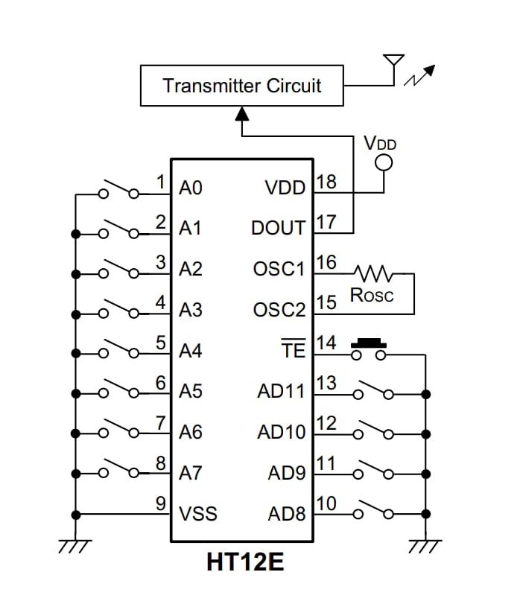
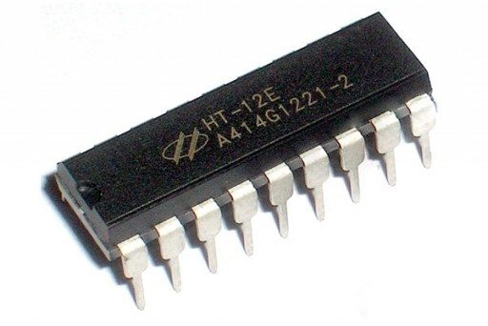
The Encoder
4 Data Bits: The encoder can send 4-bit parallel data inputs (AD8–AD11).
8 Address Bits: 8 bits of address (A0–A7) can configurated for unique identification, useful for avoiding interference between devices.
Serial Transmission: Encodes the address and data bits into a serial output (Dout).
Built-in Oscillator: Requires only a resistor to set the oscillator frequency (the rate at which the serial data is transmitted).
TE (inverted) is controlling the transmission, where in our project its set to ground for continuous transmission.

Slide 7
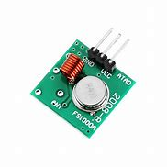
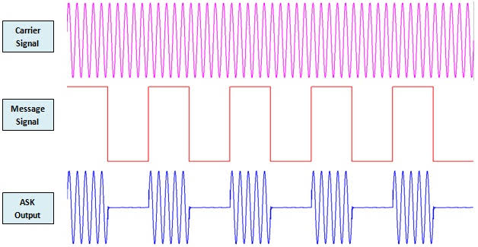
The Transmitter
it uses the serial output of the encoder to produce an ASK modulated signal that is suitable for transmission through the antenna.

Slide 8
The car circuit

Slide 9


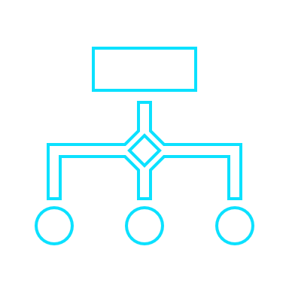

The car circuit
Receiver
Decoder
Logic Processing
Motor Driver
It demodulates the received signal to return the original serial signal.
Compares the address of the serial signal and decodes it into the 4 bits
It processes the 4 bits data into a code that is understandable by the motor driver IC.
The connection between the circuit and the motors where it receives one enable and two inputs for each motor

Slide 10
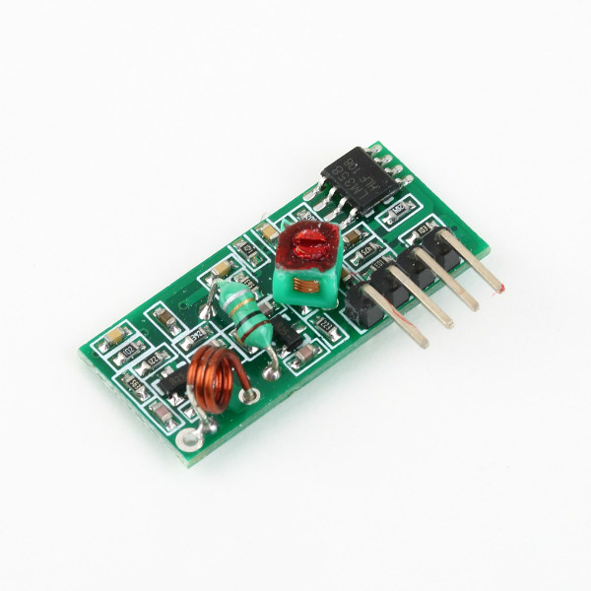
The receiver
Its an ASK Demodulator Circuit that retrieves the original serial signal from received modulated signal

Slide 11
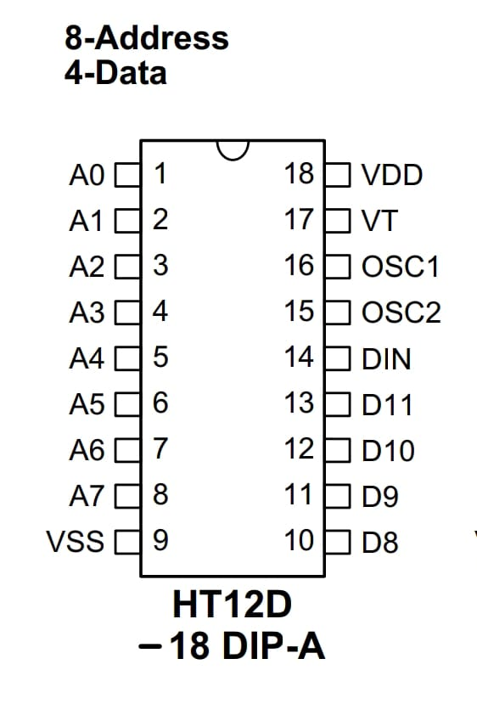
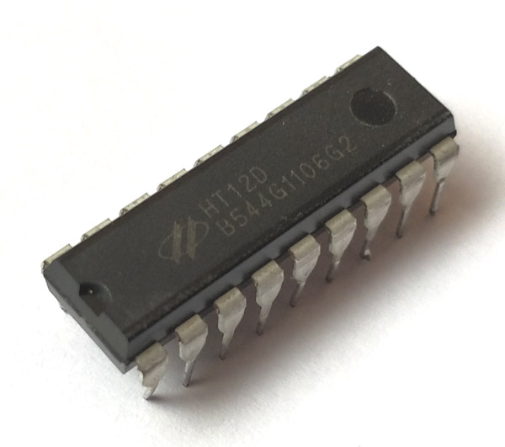
Decoder
Data Reception: The DIN pin receives the encoded serial data from the RF receiver.
Address Matching: The decoder checks the address bits (A0–A7). If they match the configured address, the decoding process continues.
Decoding: The HT12D decodes the serial data back into parallel 4-bit data and outputs it on pins D8–D11.
Validation: The VT (Valid Transmission) pin goes high to indicate valid data reception.
The OSC1 and OSC2 pins are used to set the internal oscillator frequency, which is required for its operation. The frequency should match the oscillator frequency of the paired HT12E encoder for proper communication.

Slide 12
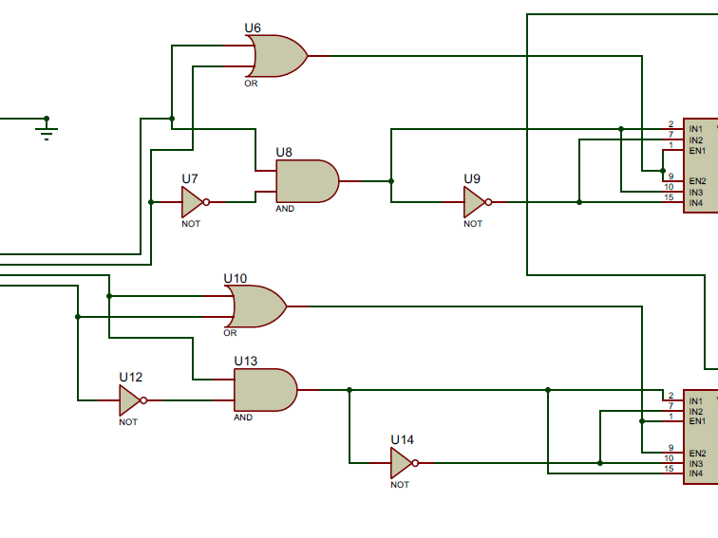
Logic processing
Since the motor driver need 3 inputs for each motor (En,in1,in2) to determine the direction of the motor and whether its on or not
For the first 2 bits (Forward and reverse):
The 2 bits is connected to an OR gate and the output in the enable(En) of the motor driver (so its on when one of the 2 bits is high )
To control the motor direction either 10 or 01 is needed, so the first bit is inverted then passed by AND gate with the second bit (so that the output would be 0 if the first bit is high or 1 if the second bit is high ),its connected to IN2.
(The AND output is inverted and connected to IN1).
So, if the first bit is high IN1 would be 1 and IN2 would be 0 and if the second bit is high IN1 would be 0 and IN2 would be 1 (the same is done for the other 2 bits)

Slide 13
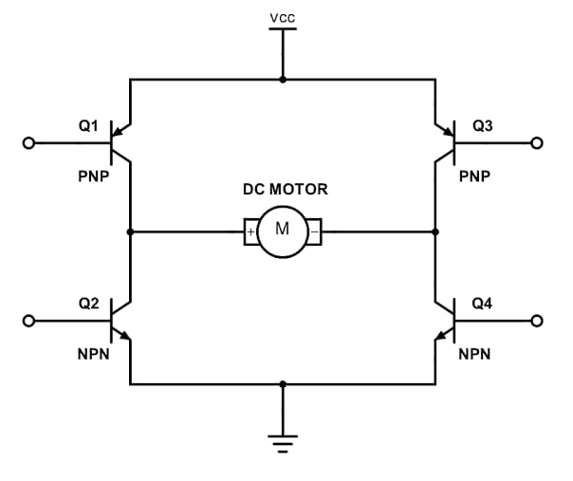
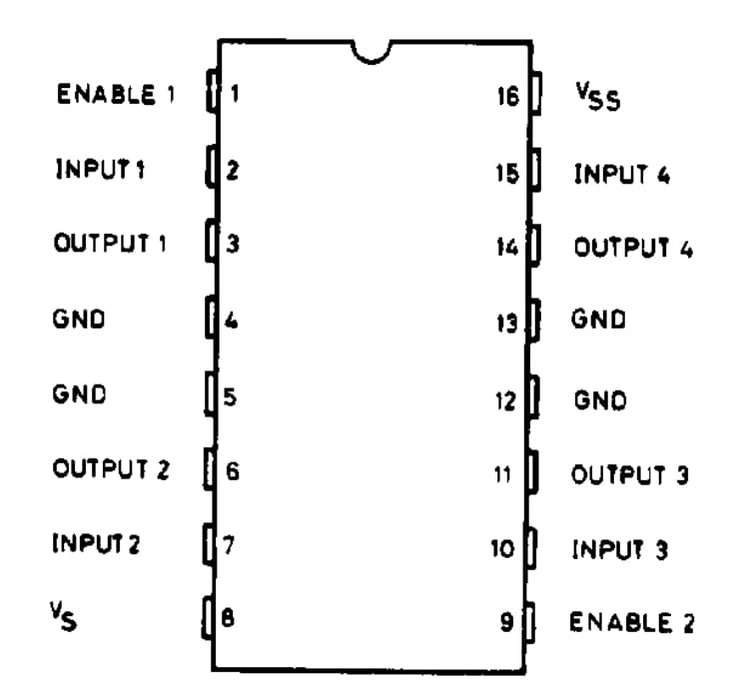
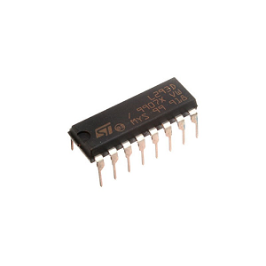
Motor Driver
L293D is a dual H-bridge motor driver that it can control two motors simultaneously based on the inputs(En,IN1,IN2).
So, for the first 2 bits (forward or reverse):
En1 is connected to En2
IN1 is connected to IN3
IN2 is connected to IN4
(so that both motors work in the same direction )
For the other 2 bits (right or left):
En1 is connected to En2
IN1 is connected to IN4
IN2 is connected to IN3
(so that the motors work in the opposite direction )

Slide 14
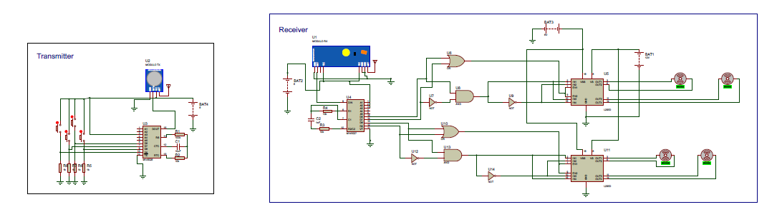
Final Circuit

Slide 15
Thanks For your time!!

